Slide 1
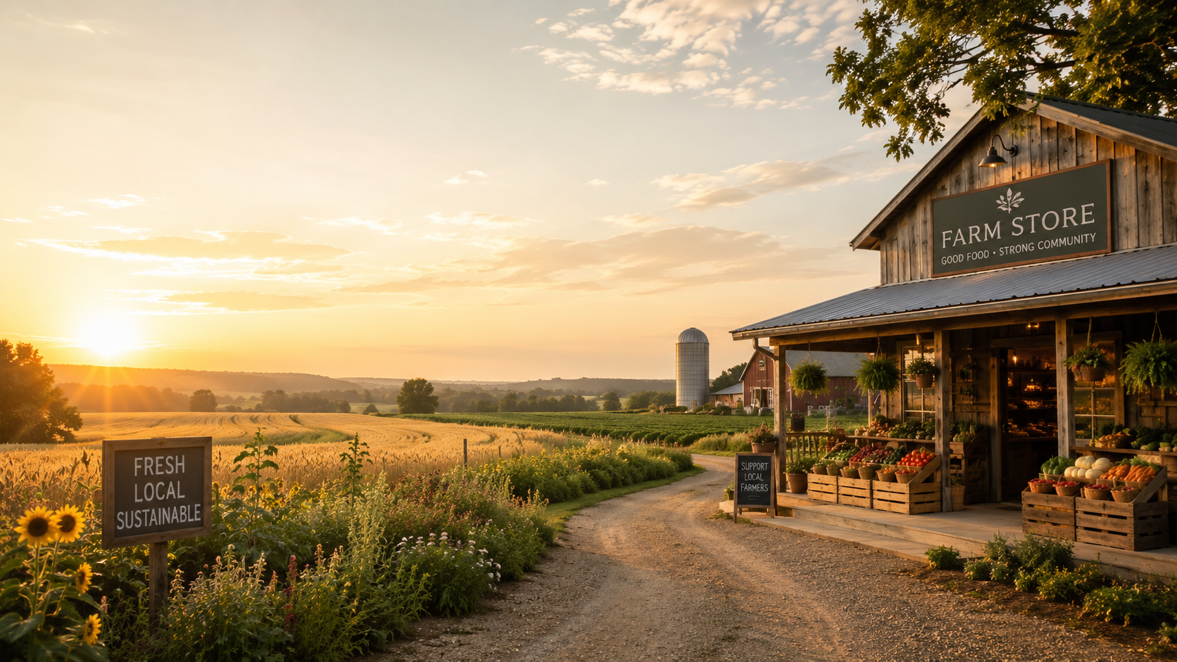
CPP FARM STORE
Omnichannel Project
Proposal
Shopify mini-store prototype + pickup workflow + operations automation
Group 1 | IBM 6540 | Summer 2026
Notes:
Sources used across deck: CPP Farm Store official pages list the address 4102 S University Dr, Pomona, CA 91768 and open daily 10 a.m.–6 p.m.; Instagram bio states “Fresh, local and CPP student grown.”

Slide 2
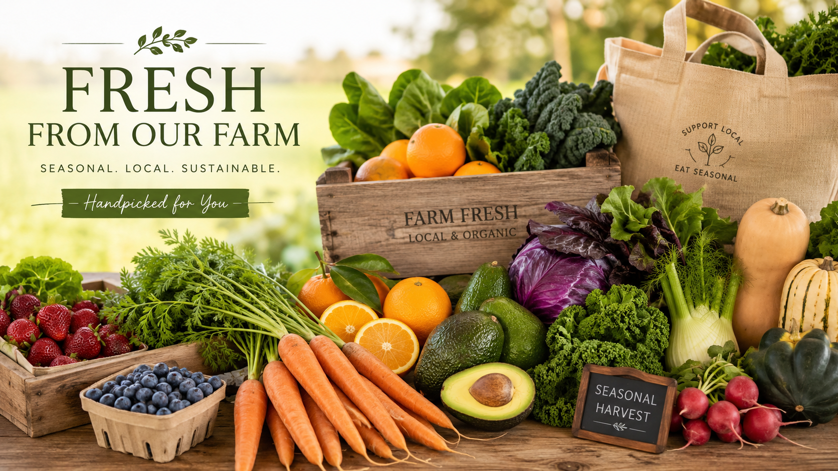
RETAILER BACKGROUND
Farm Store at Kellogg Ranch
CPP Farm Store is a campus-connected specialty food retailer that brings together student-grown agriculture, fresh produce, local goods, gifts, and seasonal products in a store environment rooted in Cal Poly Pomona’s “learn by doing” culture.
Brief History
Mission Statement
Located at Kellogg Ranch / AGRIscapes, the store connects CPP agriculture with a public-facing retail experience.
Fresh, local, CPP student-grown products and one-of-a-kind shopping experience.
Retail Format
Location
Campus farm store: fresh produce, specialty foods, gift shop, curbside/pickup potential.
4102 S. University Dr.
Pomona, CA 91768
Open daily 10 a.m.–6 p.m.
CPP Farm Store Omnichannel Proposal | 2/10
Notes:
Official CPP Farm Store contact page gives location and hours. CPP Farm Store Instagram describes the store as fresh, local, and CPP student grown.

Slide 3
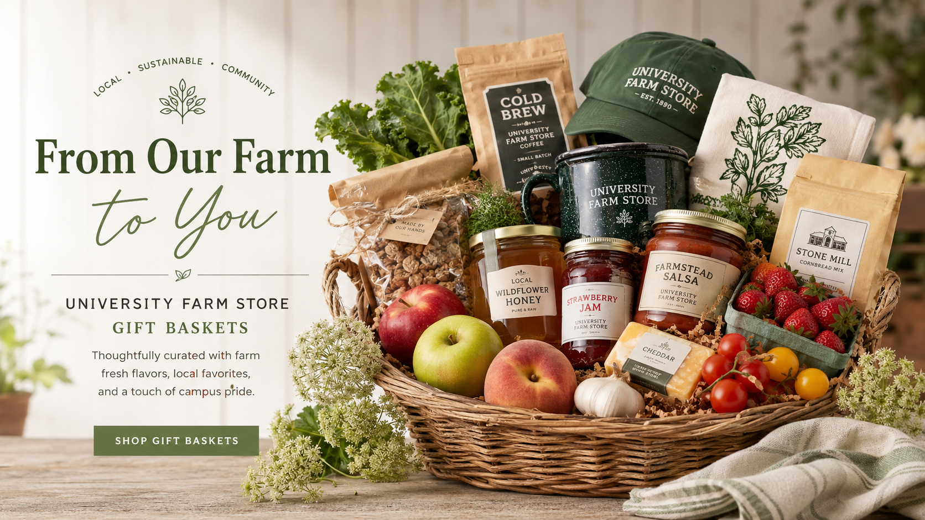
CLIENT UNDERSTANDING
A local retail experience with digital growth potential
The Farm Store’s strength is its local trust and product story. The digital opportunity is to make that product story easier to discover, browse, and act on before a customer visits the physical store.
Current strength
Customer need
Fresh/local assortment, campus identity, gift baskets, specialty items, community trust.
Know what is available, what can be picked up, and what products fit a gift or visit.
Digital gap
Proposal focus
Product discovery, category navigation, pickup expectations, and order communication can be clearer.
Build a prototype ecommerce experience that supports online-to-offline behavior.
CPP Farm Store Omnichannel Proposal | 3/10

Slide 4
PROBLEM DEFINITION
Customers need confidence before they visit or order
A farm store assortment changes by season and inventory. Without a clear online product experience, customers may not know what is available, how pickup works, or whether a gift order needs extra preparation time.
Discovery friction
Pickup uncertainty
Operations burden
Measurement gap
Customers cannot easily browse categories, featured products, seasonal bundles, or CPP favorites before visiting.
Gift baskets and custom orders need clear lead times, notes, and pickup guidance.
Staff need a simple way to capture order details, gift notes, and prep status.
Leadership needs visibility into digital demand and product interest.
Opportunity: connect product storytelling, customer education, and lightweight operations automation into one omnichannel prototype.
CPP Farm Store Omnichannel Proposal | 4/10

Slide 5
OBJECTIVES
Business objectives → project objectives
Business Objective 1: Improve product discovery
Project Objective 1
Help customers understand the Farm Store assortment before visiting or placing a pickup/gift order.
Create a Shopify mini-store prototype with collections, product pages, cart UX, and policy content.
Business Objective 2: Support online-to-offline sales
Project Objective 2
Use Shopify to present products, guide customers to pickup, and reduce confusion around fulfillment.
Build mock customer journeys for browse → cart → checkout/pickup → confirmation.
Business Objective 3: Improve operational readiness
Project Objective 3
Use eSync for Clover POS integration, Zapier workflow builder, and Google Sheets to model POS activity, order tracking, and inventory handoff.
Create operational deliverables: order tracker, gift workflow, inventory fields, and reporting dashboard.
CPP Farm Store Omnichannel Proposal | 5/10

Slide 6
METHODS
How we will build and validate the proposal
Review Farm Store's site, social channels, and in-store assortment to document current product mix and customer touchpoints.
Organize products into collections (produce, specialty foods, gifts, merch) and identify pickup-only vs. shippable SKUs.
Build the Shopify mini-store: collections, product pages, cart, and pickup/policy content on the dev store.
Prototype order intake, gift-note capture, and prep-status tracking using Zapier and Google Sheets.
Test the browse-to-pickup journey end to end and diagnose the product feed against Google Merchant Center requirements.
1. Client scan
2. Assortment mapping
3. UX prototyping
4. Ops workflow
5. Evaluation
CPP Farm Store Omnichannel Proposal | 6/10

Slide 7
OMNICHANNEL SYSTEM
Proposed experience architecture
The proposed system separates the customer-facing storefront from the operational workflow, while keeping the journey simple for shoppers and manageable for staff.
Customer-facing storefront: catalog, collections, cart, checkout, pickup selection.
Automation layer: new orders trigger tracker rows, gift-note alerts, and confirmation emails.
Product feed powers free listings and Local Inventory Ads so items surface in Search before a visit.
eSync keeps in-store inventory and online availability aligned, avoiding overselling pickup items.
Shopify
Zapier
Google Merchant Tools
Clover POS Syncing
Know what's in stock, order ahead, and pick up with confidence.
One tracker with order details, gift notes, and prep status — no new systems to learn.
Digital demand data and product-interest visibility that leadership currently lacks.
Customer result
Staff result
Business result
CPP Farm Store Omnichannel Proposal | 7/10

Slide 8
MOCK DELIVERABLES
What the final project will show
Live dev store with themed homepage and navigation
Product catalog across produce, specialty, gifts, merch
1. Shopify mini-store
2. Product catalog
Browse → cart → pickup → confirmation walkthrough with gift-note capture
Google Sheets order tracker fed by Zapier
3. Gift order journey
4. Operations tracker
Deliverables will be presented as screenshots, walkthrough notes, and implementation documentation.
Working Zap: order → tracker row → notification
Dashboard summarizing orders, top products, and feed health
5. Automation prototype
6. Reporting view
CPP Farm Store Omnichannel Proposal | 8/10

Slide 9
MILESTONES & TIMELINE
Four-week proposal build plan
Week 1
Discovery
Week 2
Build
Week 3
Presentation
Week 4
Presentation
Client scan
Assortment map
Collection structure
Scope confirmation
Product catalog
Theme sections
Cart/pickup UX
Policy pages
Zapier automation
order tracker
GMC feed setup
feed-quality diagnosis
Finalize deck
Document insights
Publish pages
Practice walkthrough
Submit deliverables
Decision checkpoint after each week: review scope, confirm deliverables, and adjust based on prototype blockers or client feedback.
CPP Farm Store Omnichannel Proposal | 9/10

Slide 10
CONCLUSION
A prototype ready for client approval
Customer confidence: browsable collections, clear pickup expectations, gift guidance
Digital front door: a working Shopify mini-store with 14 feed-ready products
Operations layer: order tracker, gift-note capture, Zapier automation
Retail-media proof: GMC feed built, 17 issues diagnosed, 2 catalog gaps fixed
Next step: approve scope → finalize prototype → present customer journey and operations workflow.
Sources: CPP Farm Store official website/contact pages; Farm Store Instagram; CPP Enterprises ice cream page; project prototype notes.
CPP Farm Store Omnichannel Proposal

Slide 11
APPENDIX
Competitor analysis: the 6 P's of retailing
Product
Promotion
CPP: campus-grown, one-of-a-kind goods — vs. TJ private label, WF breadth, Sprouts fresh-value.
CPP: Instagram + campus word-of-mouth, retail media via GP3 — vs. flyers, Prime, weekly ads.
Price
Presentation
CPP: mid-range, premium on gifts — vs. TJ value pricing, WF premium, Sprouts promo-driven.
CPP: farm-stand authenticity, the "learn by doing" story — vs. themed or polished chain formats.
Place
Personnel
CPP: single campus location with pickup potential — vs. dense suburban chain networks 15–20 min out.
CPP: students and staff, education as part of the experience — vs. standard grocery staffing.
CPP Farm Store Omnichannel Proposal

Slide 12
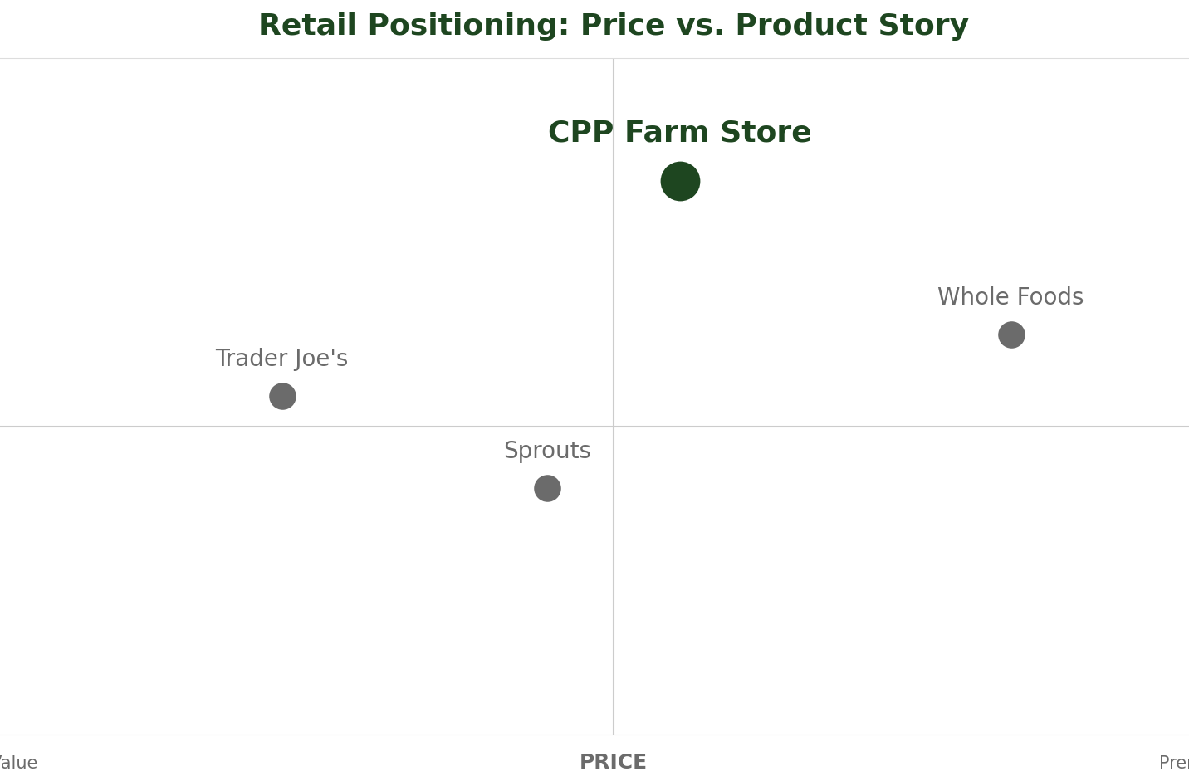
APPENDIX
Store positioning and perceptual map
For gift buyers, local-food shoppers, and the campus community, CPP Farm Store is the only retailer whose products are grown, made, and sold by Cal Poly Pomona students — authenticity no chain can match, at a fair price.
Map axes
CPP position
X: price, value to premium. Y: product story, commodity to authentic/local.
Mid price, highest authenticity — alone in the upper-middle quadrant.
Competitor spread
Implication
TJ value-curated; Sprouts mid-value fresh; Whole Foods premium-story.
Compete on story and experience — never on price or assortment breadth.
CPP Farm Store Omnichannel Proposal

Slide 13
APPENDIX
Trade area analysis
The Farm Store serves three demand rings: a captive campus core, a family-oriented local ring, and a statewide gift audience reachable only through the ecommerce channel this proposal builds.
Primary: 0–10 min
Secondary: 10–25 min
Tertiary: online
Competitive gap
CPP students, faculty, staff, and AGRIscapes visitors — captive weekday demand aligned with store hours.
Pomona, Walnut, Diamond Bar, Chino Hills, La Verne, Claremont — weekend families and gift buyers.
Alumni and gift shippers statewide, served by shippable SKUs: salsa, honey, fruit boxes.
No on-campus or farm-direct competitor inside the primary zone.
Local Inventory Ads (GP3) target the primary and secondary rings: "available for pickup today at Kellogg Ranch."
CPP Farm Store Omnichannel Proposal

Slide 14
APPENDIX
Additional information
Supporting materials for this proposal are published and available for review alongside the deck.
GP3 report
Feed workbook
Product feed, 17-issue diagnosis, and retail-media strategy — on the group GitHub Pages.
Five-tab Excel workbook in the group repo under assignments/GP3.
Live prototype
Location
cpp-farm-store-dev.myshopify.com — password-protected Shopify dev store.
4102 S. University Dr.
Pomona, CA 91768
Open daily 10 a.m.–6 p.m.
CPP Farm Store Omnichannel Proposal

Slide 15
REFERENCES
Sources
This proposal draws on client-published materials, platform documentation, the group’s own project deliverables, and in-person field research.
Client sources
Platform docs
CPP Farm Store official website and contact pages; Farm Store Instagram; CPP Enterprises program pages.
Google Merchant Center product data spec and Local Inventory Ads requirements; Shopify Google & YouTube channel docs.
Group deliverables
Field research
GP1 journey map; GP2 prototype report; GP3 feed workbook — mjshawell/cpp-farm-store-theme.
In-store observations:
Trader Joe's, Whole Foods,
Sprouts — Brea, CA.
CPP Farm Store Omnichannel Proposal

